Slide 1
Digital Forensics – COMP 5350/6350
-Aravipati

Slide 2
Today’s Topics
Introduction to Kali Linux
Nmap
Wireshark
Metasploitable

Slide 3
Kali Linux
Previous version is Backtrack
Debian-based Linux distribution
Mainly designed for penetration testing, forensics and Reverse engineering.
It comes with 600 tools which serves innumerable purposes.
This session, we will learn about Nmap, WireShark, Foremost, Scalpel

Slide 4
Post Kali installation
Update the system with apt-get update
Check for recent software updates apt-get dist-upgrade
Setup administrator account. How?
Go to dropdown menu at top right of your Kali Desktop screen.
Root> Account settings > User accounts > ADD user
Account Type – administrator . Id and pwd of your choice. To use the tools like Wireshark you must use admin account but not root.

Slide 5
Nmap
Network Scanner
Primary functions – Network Exploration and Security auditing
Forensic purposes
Identify vulnerabilities in a network firewall
Give information of ports/ services running on the ports
For all the talk we have been doing about ports, Ipaddress, protocols – this might be a good start to explore them.

Slide 6
Nmap commands
nmap <ipaddress> This gives a list of ports that are open currently.
This gives a list of all ports that are open
nmap –A <ipaddress> This gives information of the type of OS machine is using and other configurations.
Use –v (verbose) with these commands to better understand what they reveal.
Above two commands are basics. If you want to learn more, try “nmap –h”. This is a very powerful tool for network scanning.

Slide 7
WireShark
Basic functionality - Packet Capture and analysis
You can examine data on different network interfaces
Forensic purpose – Packet analysis helps in tracking recipients and senders of any communication.
What is a Packet? (Header/Payload/Error Checking)
To experiment with this tool, Wireshark provides packet dumps at wiresharkbook.com

Slide 8
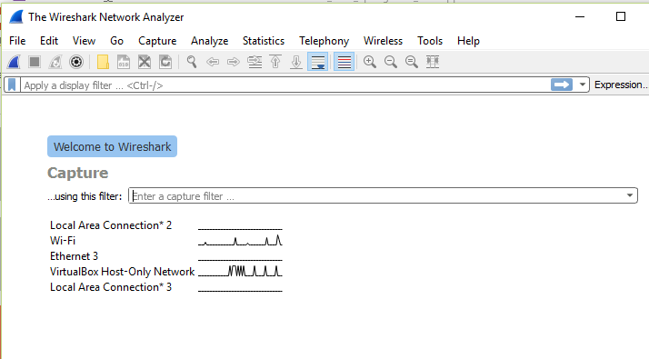
Wireshark - Screenshot

Slide 9
Data Carving
It is a technique to recover data as a whole or in fragments when the data entries are deleted or corrupted on the directory level.
It is carried out based on type-specific header and footer values.
In other words, Data carving makes use of internal structure of the file.
Data recovery techniques usually depend on the structure of file system. This is the difference between data carving and data recovery.

Slide 10
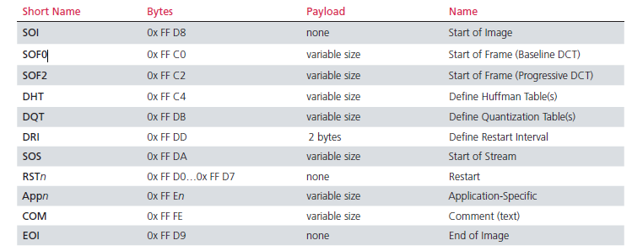
Data carving example

Slide 11
Tools for data carving
Tools for data carving are designed based on the data blocks.
Tools that can be used for different file types are Foremost, Scalpel.
(There are a whole bunch of tools that are available online – Today we will learn about Foremost and Scalpel)

Slide 12
Foremost
Foremost <drive/inputimage>
Above command is used in combination with
-v Verbose
-t To specify file type
-T To create output directory with timestamp
-q To speed up the process – it may skip some files
-i To specify input file/drive
-o To specify output file/folder

Slide 13
Scalpel usage
Scalpel <inputimage>
When you are using scalpel for the first time, you have to edit the scalpel.conf file and take off the comments from the lines where the required file types are mentioned.
-o is used to specify the output file/directory.

Slide 14
Activity
https://drive.google.com/file/d/0BxbmzYGDiZ-ReUNBMEdodnU5dDg/view?usp=sharing
Download this image file.
Use Foremost and Scalpel.
List atleast two differences between Foremost and Scalpel.

